Slide 1



Best Practices and Architectures
Domain Driven Design
Databases
Frameworks
SoftUni Team
Technical Trainers
Software University
http://softuni.bg

Slide 2

Table of Content
Domain Driven Design

Slide 3
Questions
sli.do #Hibernate

Slide 4

Domain Driven Design

Slide 5
Spring Web Architecture
Web Layer
(controller, exception handlers, view templates)
DTO’s
public
Service Layer (application and infrastructure services)
Domain model
(entities, value objects, services)
private
Repository Layer
(repositories, interfaces and implementations)

Slide 6
Spring Layers
Web layer - the uppermost layer of a web application. It is responsible of processing user’s input and returning the correct response back to the user. The web layer must also handle the exceptions thrown by the other layers. Because the web layer is the entry point of our application, it must take care of authentication and act as a first line of defense against unauthorized users.
Service layer - resides below the web layer. It acts as a transaction boundary and contains both application and infrastructure services. The service layer takes data transfer objects as method parameters. It can handle domain model objects but it can return only data transfer objects back to the web layer.
Repository layer - the lowest layer of a web application. It is responsible of communicating with the used data storage. It takes entities as method parameters and returns entities.

Slide 7
Domain Driven Design
Entity – a model that has identity and business logic
Aggregate Root – an entity which aggregates another entity
Value Object – an immutable POJO without identity
Factory – a class that creates Entities, Aggregates and Value Objects
Repository – a class that persists Entities and Aggregate Roots
Service – a layer that implements business logic

Slide 8
Domain Driven Design
Service
Repository
Models
Entity
DB
Root Aggregate
Value Object
DTO
Factory

Slide 9
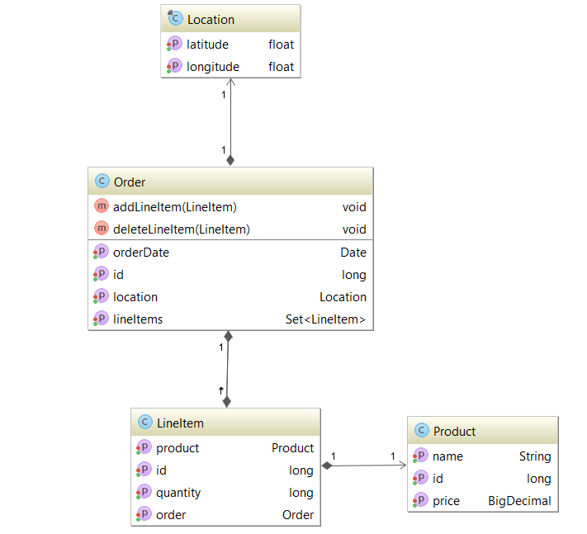
Domain Driven Design Example
Value Object
Aggregate Root
Entity
Entity

Slide 10
Entity
Bean object
Implements Serializable
Has id
Has Empty Constructor
Has Getters and Setters
Has Internal Logic
Has mapping to a Table

Slide 11
Entity
Product.java
@Entity
@Table(name = "products")
public class Product implements Serializable {
@Id
@GeneratedValue(strategy = GenerationType.IDENTITY)
private long id;
@Column(name = "name")
private String name;
@Column(name = "price")
private BigDecimal price;
public Product() {
}
}

Slide 12
Aggregation Root
Bean object
Implements Serializable
Has id
Has Empty Constructor
Has Getters and Setters
Has Internal Logic
Has mapping to a Table
Aggregates Entity

Slide 13
Aggregate Root
Order.java
@Entity
@Table(name = "orders")
public class Order implements Serializable {
@Id
@GeneratedValue(strategy = GenerationType.IDENTITY)
private long id;
@Column(name = "order_date")
private Date orderDate;
@OneToMany(mappedBy = "order", targetEntity = LineItem.class)
private Set<LineItem> lineItems;
@Transient
private Location location;
public Order() {
}
}
Aggregation

Slide 14
Value Object
POJO
Immutable
Not Recorded to a database
Can be embedded in an Entity

Slide 15
Factory
Immutable
Location.java
public final class Location {
private float latitude;
private float longitude;
public Location() {
Random randomGenerator = new Random();
this.latitude = randomGenerator.nextFloat();
this.longitude = randomGenerator.nextFloat();
}
}

Slide 16
DTO
POJO
Only carries information
Not Recorded to a database
Can be transformed into an Entity

Slide 17
DTO
ProductDto.java
public class ProductDto {
private String name;
private BigDecimal price;
private long quantity;
}
Carry information

Slide 18
Factory
Creates Entities
Creates Aggregation Roots
Should be defined as Bean

Slide 19
Factory
OrderFactory.java
public class OrderFactory {
public Order create(Location location, Date orderDate){
Order order = new Order();
order.setLocation(location);
order.setOrderDate(orderDate);
return order;
}
}
JavaConfig.java
@Configuration
public class JavaConfig {
@Bean
public OrderFactory orderFactoryFactory(){
return new OrderFactory();
}
}
Bean Definition

Slide 20
Repository
Persists Entities into a Database
Retrieves Entities from a Database
Has @Repository Annotation
Can have @Transactional Annotation

Slide 21
Repository
OrderRepository.java
@Repository
public interface OrderRepository extends JpaRepository<Order, Long>{
}

Slide 22
Service
Handles Business Logic
Has @Service Annotation
Can take DTO as Parameter
Can return DTO
Can work with Repositories
Can work with Factories

Slide 23
Service
OrderService.java
@Service
public class OrderService {
@Autowired
private OrderRepository orderRepository;
@Autowired
private OrderFactory orderFactory;
public Order create(Location location, Date date){
Order order = this.orderFactory.create(location, date);
this.create(order);
return order;
}
public Order create(Order order){
this.orderRepository.saveAndFlush(order);
return order;
}
}

Slide 24
Repository Pattern
Single Repository per Entity
The Repository is responsible to persist Entities
The Repository is responsible to retrieve Entities
The Repository is responsible to update Entities
The Repository is responsible to delete Entities
The Repository is responsible to retrieve Entities based on some criteria

Slide 25
Repository Pattern
Models
Save
Save
Entity
DB
Repository
Retrieve
Retrieve
Root Aggregate

Slide 26
Service Pattern
Services handle the business object related to Entities
Services are used by Controllers
Services handle DTO objects

Slide 27
Service Pattern
Controller
DTO
Transforms
Used by
Service
Models
Uses
Save
Save
Entity
DB
Repository
Retrieve
Retrieve
Root Aggregate

Slide 28

Summary
Domain Driven Design

Slide 29









JDBC
https://softuni.bg/courses/

Slide 30
SoftUni Diamond Partners

Slide 31
License
This course (slides, examples, demos, videos, homework, etc.) is licensed under the "Creative Commons Attribution-NonCommercial-ShareAlike 4.0 International" license
Attribution: this work may contain portions from
"Databases" course by Telerik Academy under CC-BY-NC-SA license

Slide 32





Free Trainings @ Software University
Software University Foundation – softuni.org
Software University – High-Quality Education, Profession and Job for Software Developers
softuni.bg
Software University @ Facebook
facebook.com/SoftwareUniversity
Software University @ YouTube
youtube.com/SoftwareUniversity
Software University Forums – forum.softuni.bg

